Slide 1

Linked Lists
June 20th, 2020
by Alex Joslin

Slide 2
What is a Linked List?
A data structure consisting of nodes where each node contains a data field and a reference to the next node.

Slide 3
Java Arrays vs Python Lists vs Linked Lists
Java Arrays
Problem:
Once you create an Array, you can’t change the size of the array, meaning you can’t add or remove items from it, only access and change items
Linked Lists
Solution:
Inserting items has O(1) time complexity (only at the beginning and end of a list)
Deleting items has O(1) time complexity
(only at the beginning of a list)
Python Lists
Problem:
Inserting items has O(n) time complexity
Deleting items has O(n) time complexity
Note: Java also has array lists which are
essentially the same thing as lists in Python

Slide 4
Time Complexities
Average Case
Operation | Linked Lists | Python Lists | Java Arrays
Insert front | O(1) | O(n) | N/A
Insert middle | O(n) | O(n) | N/A
Insert end (Append) | O(1) | O(1) | N/A
Delete front | O(1) | O(n) | N/A
Delete middle | O(n) | O(n) | N/A
Delete end | O(n) | O(1) | N/A
Access element | O(n) | O(1) | O(1)
Search | O(n) | O(n) | O(n)
Get Length | O(1) | O(1) | O(1)

Slide 5
How do Linked Lists Look Like?
List / Array
Linked List
None

Slide 6

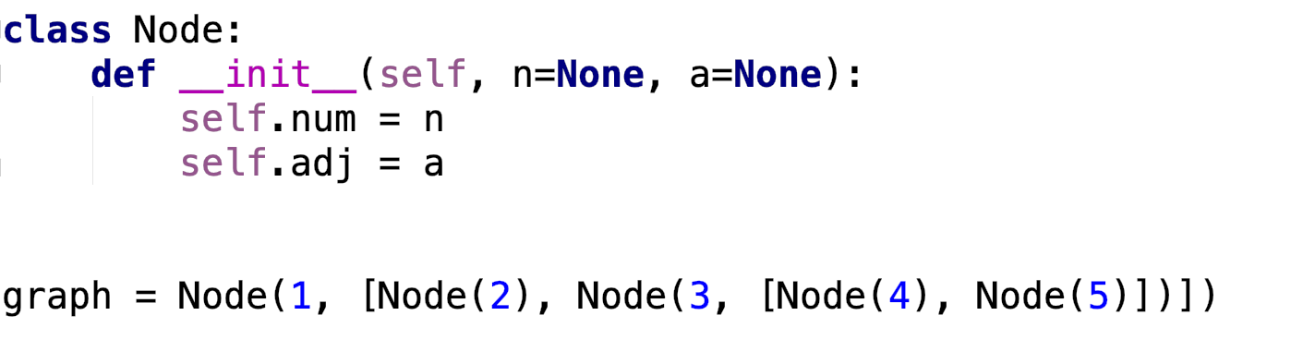
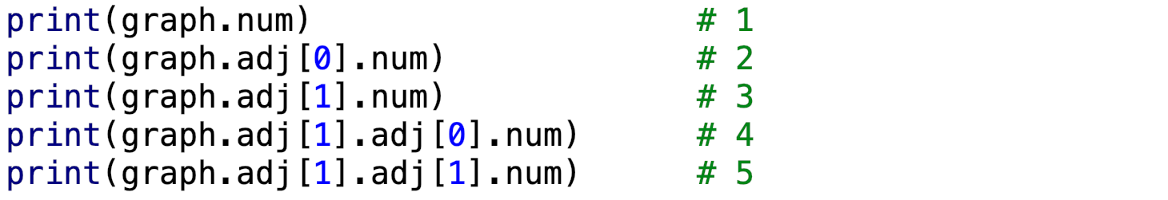
Graph creation with Objects
2
1
4
3
5

Slide 7
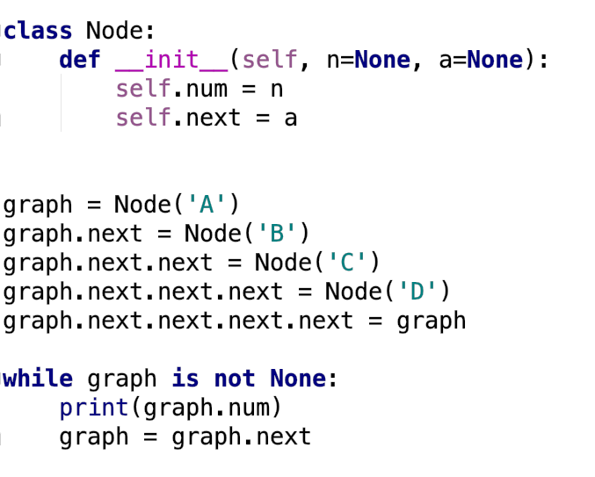
Graph creation with Objects
Output
graph
B
A
C
D
ect ...

Slide 8
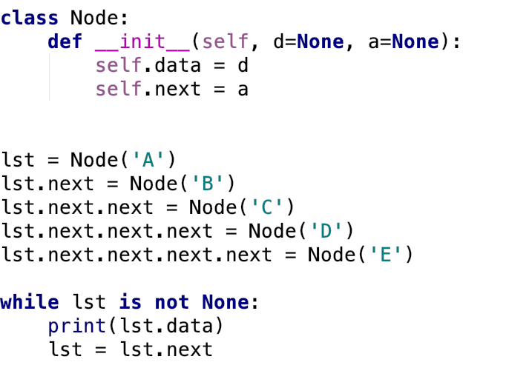

Graph creation with Objects
Output
lst
self.data
self.data
self.data
self.data
self.data
None
self.next
self.next
self.next
self.next
self.next

Slide 9
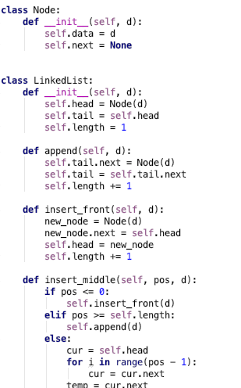
Implementation
self.data = 2
self.next
= next_node
self.data = 9
self.next
= next_node
self.data = 3
self.next
= next_node
self.data = 5
self.next
= next_node
None
self.head
self.tail

Slide 10
Insertion

Slide 11
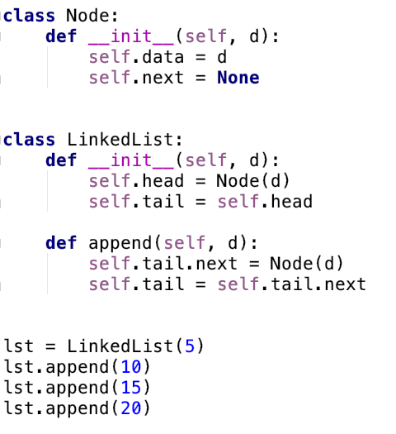
Insert_back (append)
head
tail
5
next
None

Slide 12
Insert_back (append)
head
tail
5
next
None

Slide 13
Insert_back (append)
head
tail
5
next
10
next
None

Slide 14
Insert_back (append)
head
tail
5
next
10
next
None

Slide 15
Insert_back (append)
head
tail
5
next
10
next
None

Slide 16
Insert_back (append)
head
tail
5
next
10
next
15
next
None

Slide 17
Insert_back (append)
head
tail
5
next
10
next
15
next
None

Slide 18
Insert_back (append)
head
tail
5
next
10
next
15
next
None

Slide 19
Insert_back (append)
head
tail
5
next
10
next
15
next
20
next
None

Slide 20
Insert_back (append)
head
tail
5
next
10
next
15
next
20
next
None

Slide 21
Insert_back (append)
head
tail
5
next
10
next
15
next
20
next
None
Time Complexity: O(1)

Slide 22
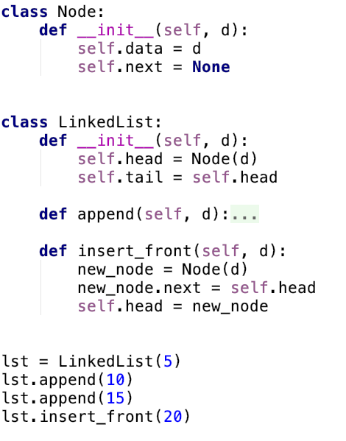
Insert_front
head
tail
5
next
10
next
15
next
None

Slide 23
Insert_front
new_node
head
tail
20
next
None
5
next
10
next
15
next
None

Slide 24
Insert_front
new_node
head
tail
20
next
5
next
10
next
15
next
None

Slide 25
Insert_front
new_node
head
tail
20
next
5
next
10
next
15
next
None

Slide 26
Insert_front
head
tail
20
next
5
next
10
next
15
next
None
Time Complexity: O(1)

Slide 27
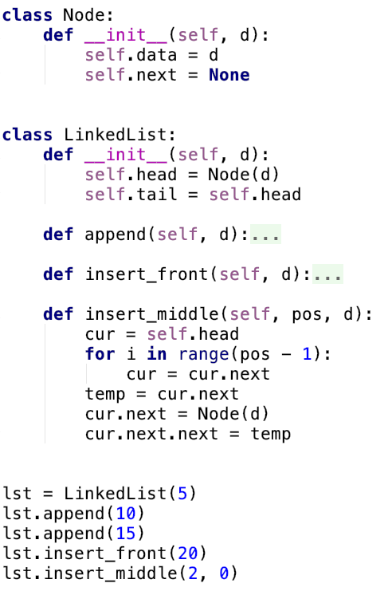
Insert_middle
head
tail
20
next
5
next
10
next
15
next
None

Slide 28
Insert_middle
head
cur
tail
20
next
5
next
10
next
15
next
None

Slide 29
Insert_middle
head
cur
tail
20
next
5
next
10
next
15
next
None

Slide 30
Insert_middle
head
cur
temp
tail
20
next
5
next
10
next
15
next
None

Slide 31
Insert_middle
head
cur
temp
tail
20
next
5
10
next
15
next
None
next
0
next
None

Slide 32
Insert_middle
head
cur
temp
tail
20
next
5
10
next
15
next
None
next
next
0

Slide 33
Insert_middle
head
tail
20
next
5
next
0
next
10
next
15
next
None
Time Complexity: O(n)

Slide 34
Deletion

Slide 35
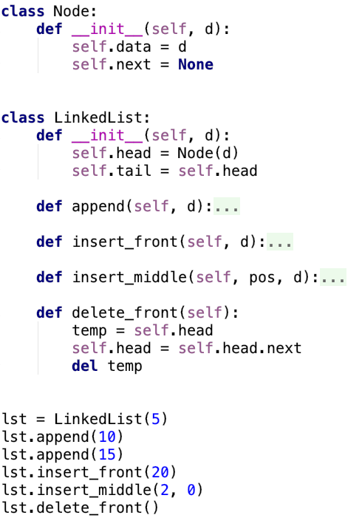
Delete_front
head
tail
20
next
5
next
0
next
10
next
15
next
None

Slide 36
Delete_front
head
temp
tail
20
next
5
next
0
next
10
next
15
next
None

Slide 37
Delete_front
temp
head
tail
20
next
5
next
0
next
10
next
15
next
None

Slide 38
Delete_front
head
tail
20
next
5
next
0
next
10
next
15
next
None

Slide 39
Delete_front
head
tail
20
next
5
next
0
next
10
next
15
next
None
Technically you don’t need to “del temp” because has garbage collection,
meaning it will automatically delete temp once the function call is deallocated
from the call stack. In other languages like C/C++ you would need to delete temp.

Slide 40
Delete_front
head
tail
5
next
0
next
10
next
15
next
None

Slide 41



Memory Deallocation
(No Garbage Collection)
Stack
Heap
C++
main()
delete_front()
temp
20
next
Reference
Count:
1
Stack
Heap
0
Python
main()
delete_front()
temp
20
next
(With Garbage Collection)

Slide 42
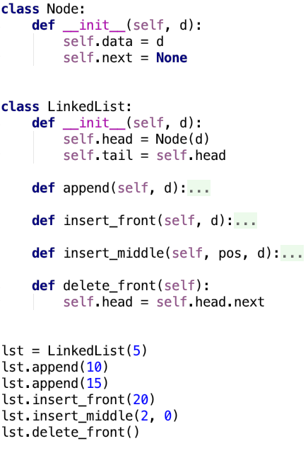
Delete_front
head
tail
20
next
5
next
0
next
10
next
15
next
None

Slide 43
Delete_front
head
tail
20
next
5
next
0
next
10
next
15
next
None

Slide 44
Delete_front
head
tail
5
next
0
next
10
next
15
next
None
Time Complexity: O(1)

Slide 45
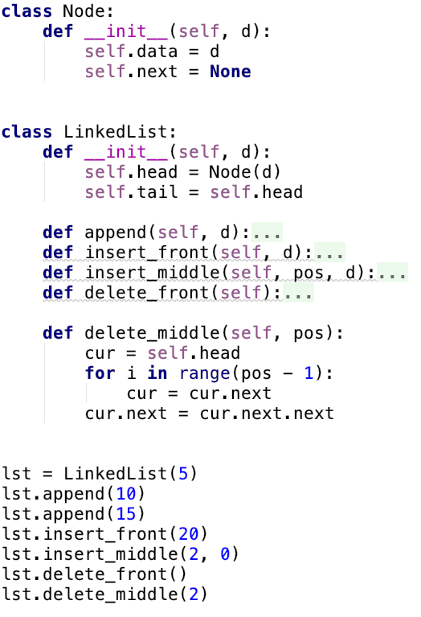
Delete_middle
head
tail
5
next
0
next
10
next
15
next
None

Slide 46
Delete_middle
head
cur
tail
5
next
0
next
10
next
15
next
None

Slide 47
Delete_middle
head
cur
tail
5
next
0
next
10
next
15
next
None

Slide 48
Delete_middle
head
cur
tail
5
next
0
10
next
15
next
None
next

Slide 49
Delete_middle
head
tail
5
next
0
15
next
None
next

Slide 50
Delete_middle
head
tail
5
next
0
next
15
next
None
Time Complexity: O(n)

Slide 51
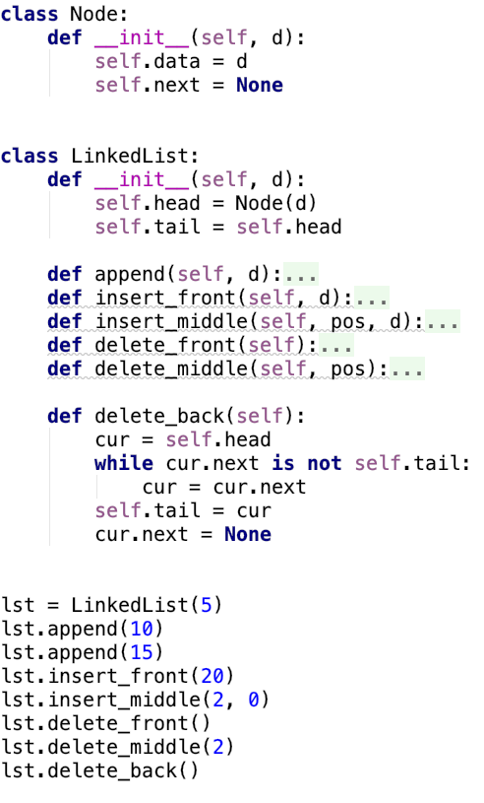
Delete_back
head
tail
5
next
0
next
15
next
None

Slide 52
Delete_back
head
cur
tail
5
next
0
next
15
next
None

Slide 53
Delete_back
head
cur
tail
5
next
0
next
15
next
None

Slide 54
Delete_back
head
cur
tail
5
next
0
next
15
next
None

Slide 55
Delete_back
head
cur
tail
5
next
0
next
None

Slide 56
Delete_back
head
tail
5
next
0
next
None
Time Complexity: O(n)

Slide 57
Other Useful Methods
display()
search()
reverse()
copy()
merge()

Slide 58
Types of Linked Lists
Linear Linked List
None
Doubly Linked List
None
None
Circular Linear Linked List
Circular Doubly Linked List

Slide 59
Notes
Note: There is a lot of confusion online on the time complexity of a linked list.
In some sites you will see that the time complexity of appending to a linked list is
O(n) but that depends on the implementation. If it is implemented without a tail
pointer it is O(n) where with a tail pointer it is (1)

Slide 60


An example of a linked list in the real world.

Slide 61
An example of a linked list in the real world.

Slide 62
An example of a linked list in the real world.

Slide 63
An example of a linked list in the real world.

Slide 64
Example of a linked list in the real world: Photo Gallery
What type of linked list is this?

Slide 65
The End

